Slide 1
Capstone project real world business analysis
Customer Churn Analysis & Retention Strategy
(Data-Driven Approach to Reduce Customer Attrition)

Slide 2
Problem statement
Customer churn is negatively impacting recurring revenue and increasing customer acquisition costs. The organization lacks a predictive system to identify high-risk customers before they leave. Current retention efforts are reactive, resulting in inefficient resource allocation. A proactive, data-driven churn prediction framework is essential to reduce attrition and safeguard long-term revenue.

Slide 3
Business impact
Rising churn significantly increases Customer Acquisition Cost (CAC), reducing marketing efficiency.
Loss of long-term customers results in recurring revenue erosion.
Lower Customer Lifetime Value (CLV) impacts overall profitability.
High churn creates instability in revenue forecasting and growth planning.

Slide 4
Project objectives
To identify the key behavioral and financial drivers influencing customer churn.
To develop a predictive churn model to estimate individual customer risk probability.
To segment and prioritize high-risk customers for targeted intervention.
To design actionable, data-driven retention strategies to reduce churn and protect revenue.

Slide 5
Dataset overview
500 customers and 9 features
Mix of numerical & categorical variables
Target variable: Churn (0 = Retained, 1 = Churned)
Key Variables:
Tenure
MonthlyCharges
Contract
PaymentMethod

Slide 6
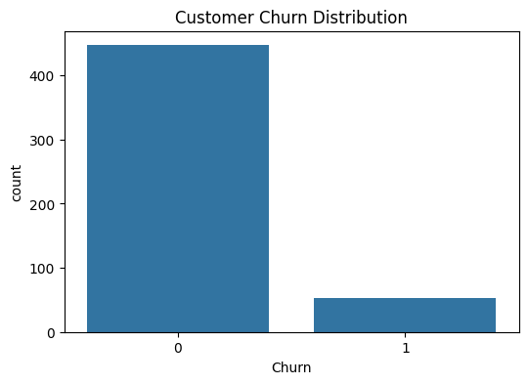
EDA – Churn Distribution
Overall churn rate identified at 10.6%
Clear class imbalance: majority customers retained
Higher churn concentration among low-tenure customers
Early customer lifecycle identified as high-risk phase

Slide 7
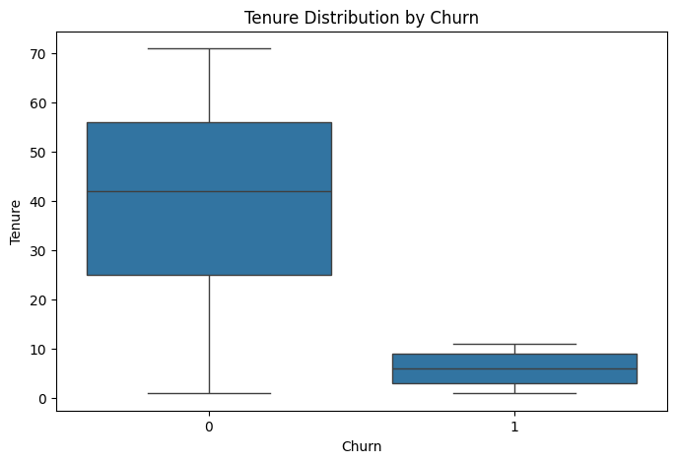
EDA – Tenure vs Churn
Churned customers show significantly lower average tenure
Strong inverse relationship between tenure and churn probability
Retention likelihood increases as tenure increases
Early-stage customers represent highest churn risk

Slide 8
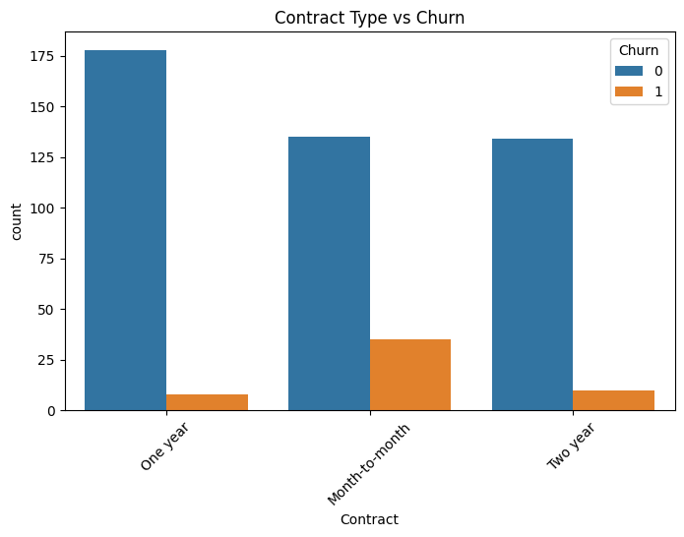
EDA – Contract Type Impact
Month-to-month contracts exhibit the highest churn rate
One-year and two-year contracts show significantly lower churn
Long-term commitment strongly improves customer retention
Contract structure is a major retention lever

Slide 9
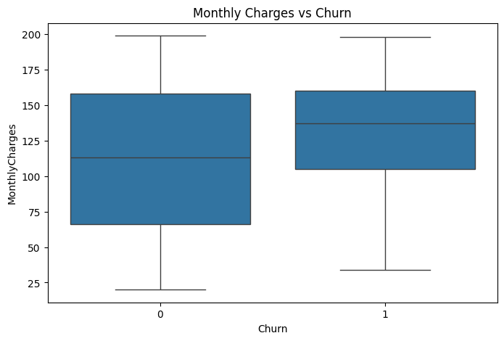
EDA – Monthly Charges Impact
Higher monthly charges are associated with increased churn probability
Customers with higher billing show greater price sensitivity
Short-tenure customers are more likely to churn when charges are high
Pricing strategy influences retention behavior

Slide 10
Key Insights
Short tenure is the strongest predictor of churn risk
Contract type significantly impacts customer retention
Higher monthly charges increase likelihood of churn
Payment method patterns influence churn behavior

Slide 11
Modelling Approach
Data cleaning and feature engineering for consistency and quality
Categorical encoding and feature scaling applied
80/20 train-test split for unbiased evaluation
Logistic Regression as baseline model
Random Forest with hyperparameter tuning for optimization
5-fold cross-validation to ensure model stability

Slide 12
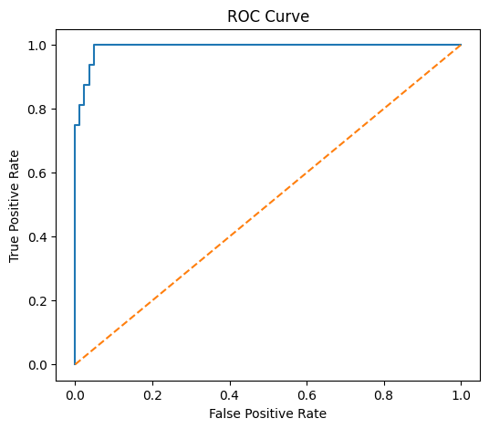
Model Performance
ROC-AUC used to evaluate model discrimination power
Random Forest outperformed Logistic Regression in overall performance
Strong recall achieved for churn class, improving detection of at-risk customers
Model generates reliable churn probability scores for risk prioritization

Slide 13
Revenue Impact Analysis
High-risk customers identified using churn probability scoring
Estimated annual revenue at risk calculated from predicted churners
Top-risk segment prioritized for targeted retention campaigns
Clear revenue protection opportunity established through proactive intervention

Slide 14
Recommendations
Incentivize month-to-month customers to upgrade to annual contracts
Launch early-retention campaigns for customers with tenure < 12 months
Offer targeted loyalty discounts to high monthly charge segments
Integrate churn prediction model into CRM for proactive intervention

Slide 15
ROI & Implementation Plan
ROI Estimate
5% churn reduction → measurable annual revenue protection
Lower customer acquisition cost through improved retention
Increased Customer Lifetime Value (CLV)
Stronger revenue predictability and growth stability
Implementation Plan
Day 1 - 2: Deploy churn prediction model into CRM
Day 3 - 4: Launch targeted retention campaigns for high-risk segment
Day 5: Track churn rate, recall, and revenue impact KPIs
Day 6 - 7: Optimize targeting rules and incentive strategy

Slide 16
conclusion
The analysis successfully identified the primary drivers of customer churn and developed a reliable predictive model to detect high-risk customers. Key factors such as short tenure, contract type, and monthly charges significantly influence churn behavior. By implementing targeted retention strategies based on these insights, the company can proactively reduce churn, protect recurring revenue, and improve long-term customer value.

Slide 17
Thank you

